Slide 1
Advanced Leopard Seal Recognition System (ALSRS): Sprint 5
Bryce Robinson, Carson Buntin, Carsyn Smeda, Nathan Hontz, Juncheng Li, Ryan Huntington, Omar Darwish
Seal Team 6

Slide 2
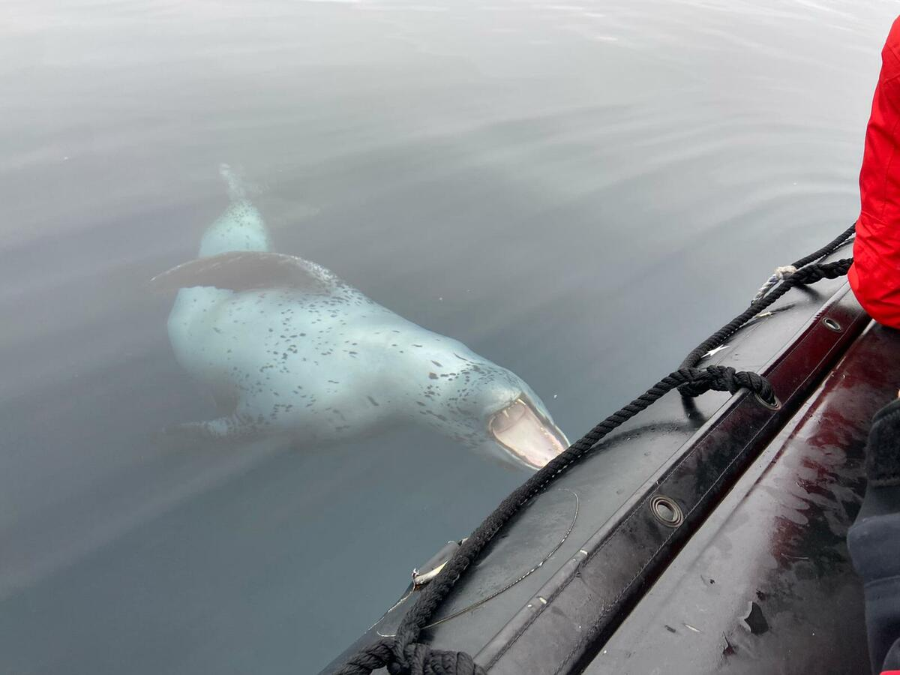
Project Review
Current lack of effective tools to detect and identify individual leopard seals
Develop API for Happywhale.com capable of receiving leopard seal photographs and returning the identity of any recognized seals
Utilization of two machine learning models for detection and identification of leopard seals
Notes:
Carsyn

Slide 3
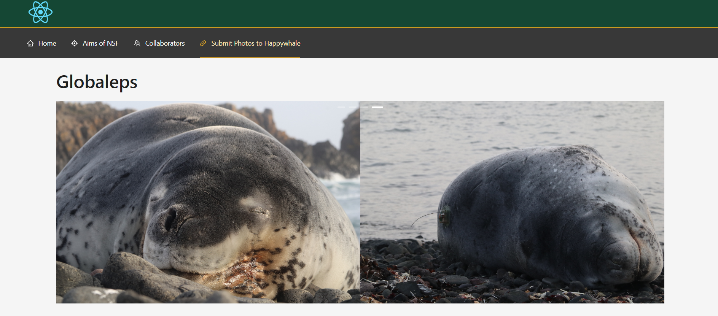
Answers from HappyWhale
Possible Limitations on GPU space
Access to code soon for client
Backup plan: Hosted on Rivas’ website and his computer network (globaleps.baylor.ai)
Will need to build basic frontend to feed images into the API
Notes:
Carson

Slide 4
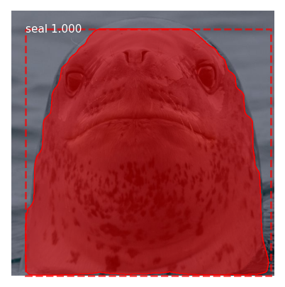
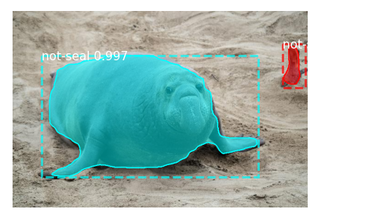
Finalize Trainings/Weights for Mask RCNN
Performed final training and modification of Mask RCNN with updated hyperparameters and epochs
Slightly better mAP score of .91
Updated .h5 model weights file to be used in full pipeline
Notes:
Nathan

Slide 5
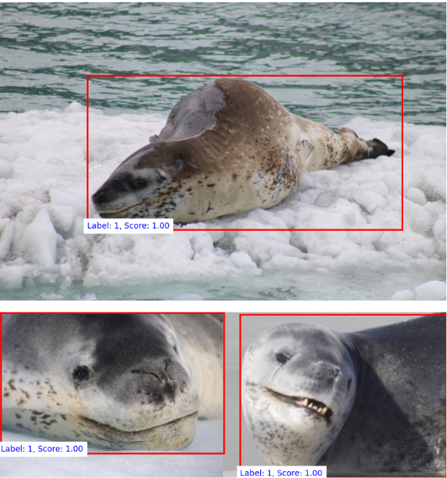
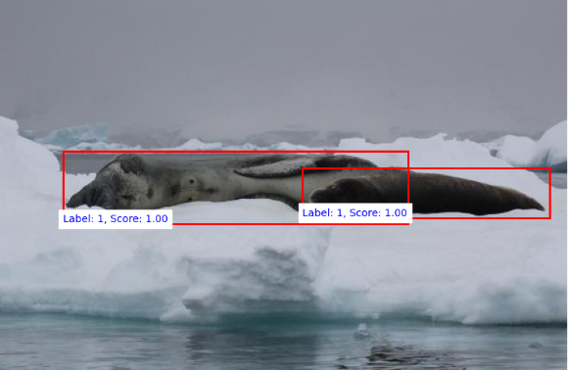
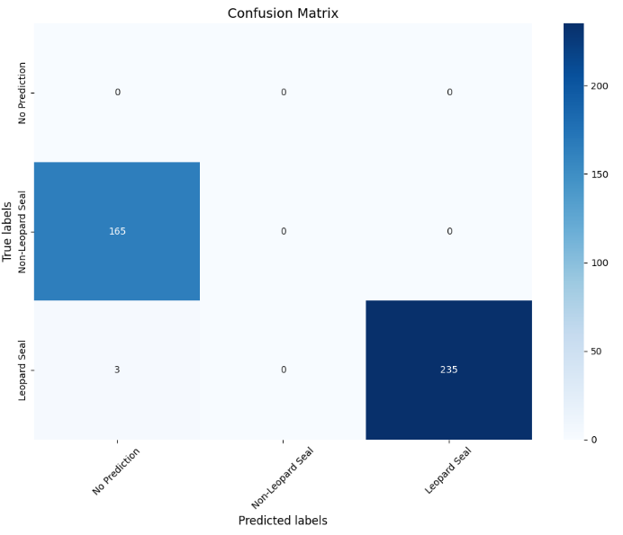
Finalize Trainings/Weights for Faster RCNN
Retrained Faster RCNN with significantly more data
Performance improved significantly
Updated the .pth model weights file to be used in full pipeline
Notes:
Juncheng

Slide 6

¿Por qué no los dos?
Keep both detection models as options to be called
Best performing model is default
Other kept as a potential alternative if default fails or returns poor results
Faster RCNN as default
Ease of training (no masks required)
Improved performance
Switch between models in application.yaml
Notes:
Nathan

Slide 7
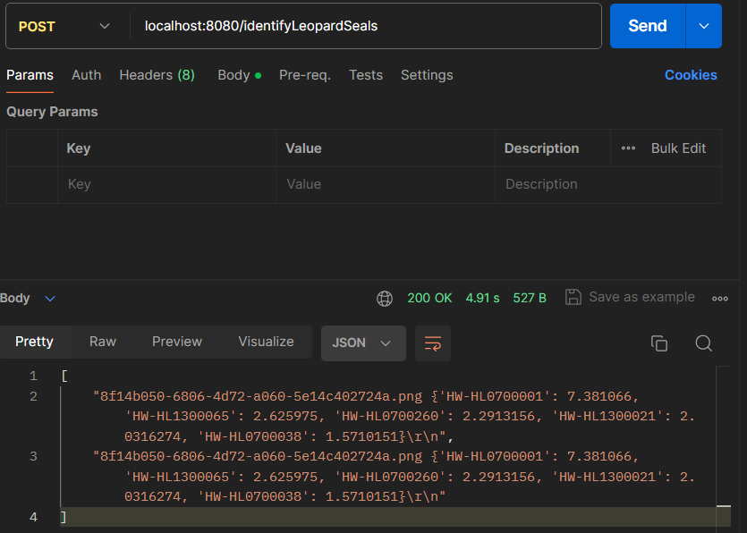
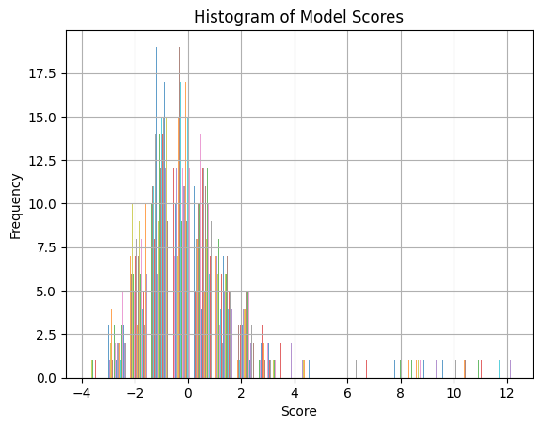
DeiT API Integration
Feed cropped image of seal to model
Load weights, make predictions, and return top 5 identities with score
Notes:
Ryan

Slide 8
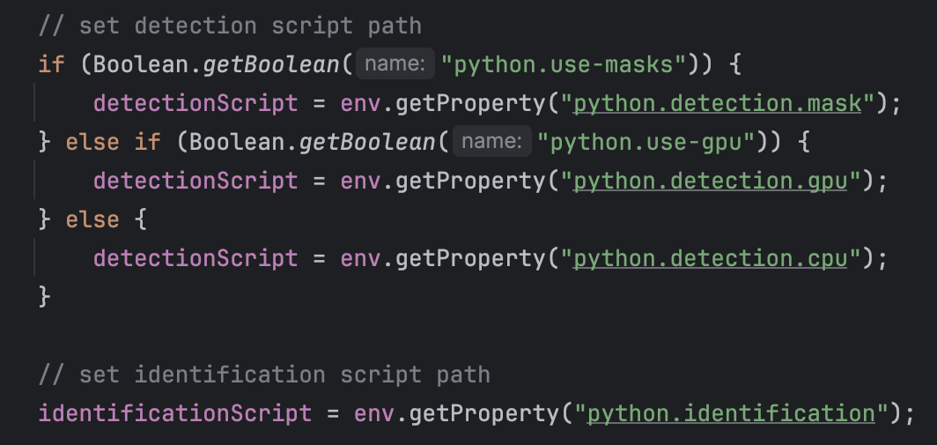
FasterRCNN API Integration
Model call testing expanded to support both detection options
Option to create model on GPUs or CPUs (boolean option in application.yaml)
Bounding box outputs formatted into strings that match MaskRCNN outputs
Notes:
Bryce

Slide 9

Full Pipeline Demo
Input Image (URL, Base64)
Detection Model
Preprocess Image
Identification Model
Output Seal Identities
Notes:
i ate with this
carsyn
A graphic designer in the making

Slide 10
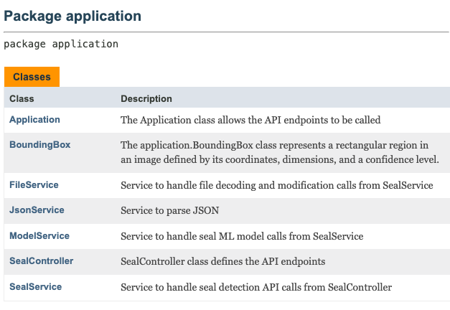
Improving API Maintainability
Separated code into 3 layered architecture
Added JavaDoc to public methods
Removed/refactored duplicate/extraneous code
Created server config file
Notes:
Bryce

Slide 11
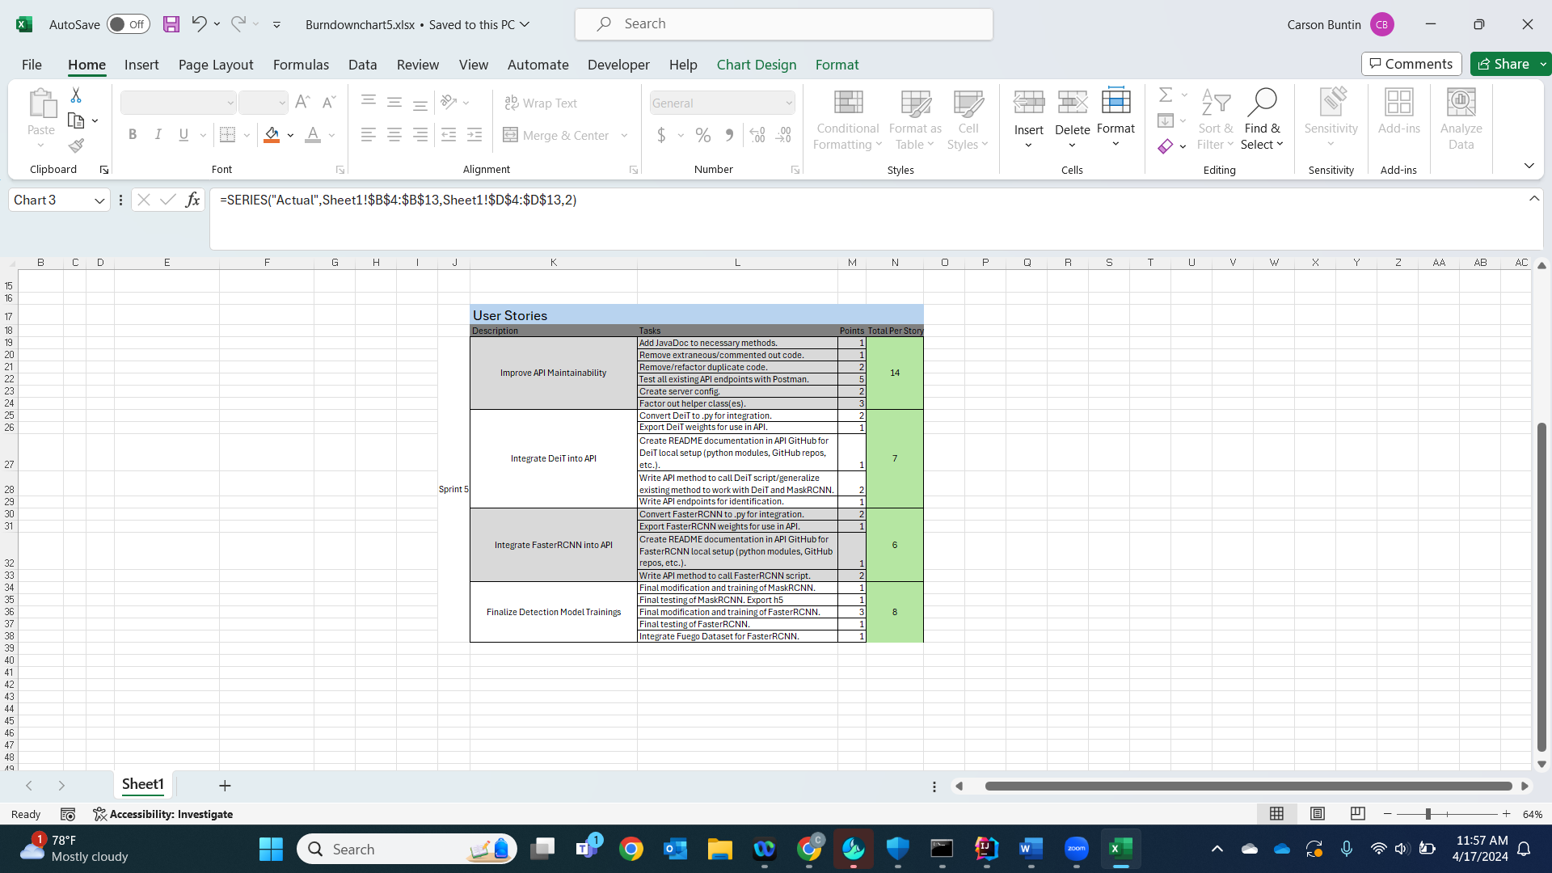
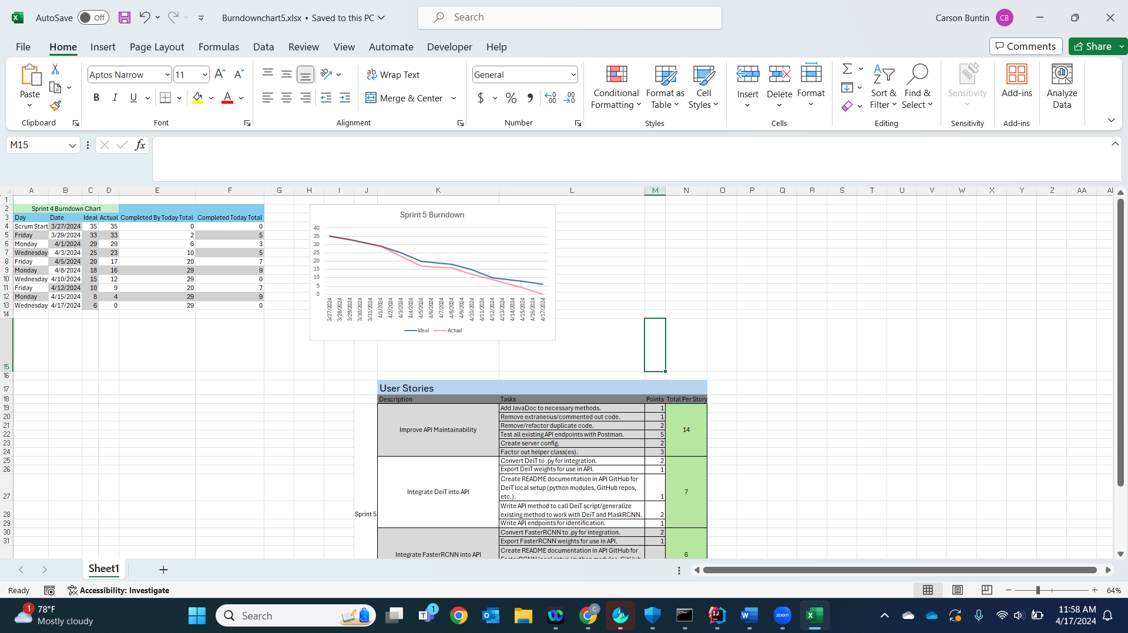
Burndown Chart and User Stories
Notes:
Carson

Slide 12
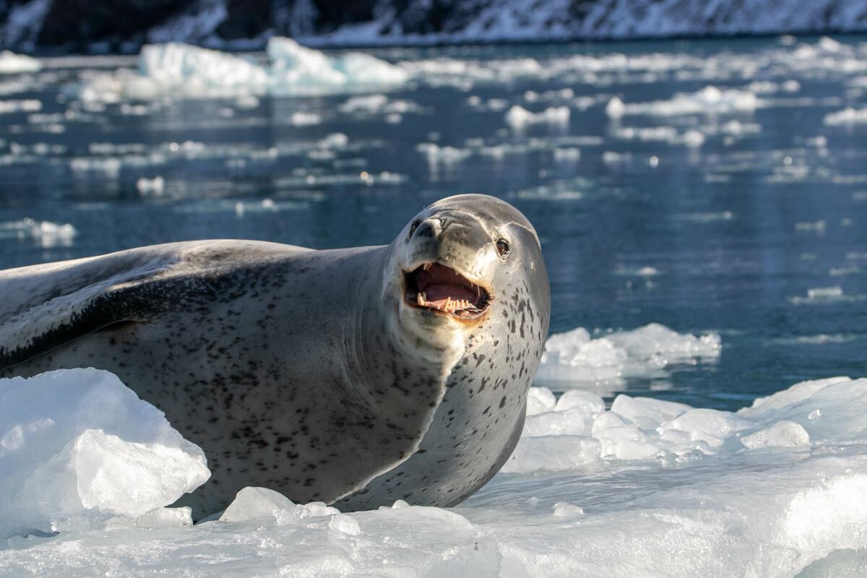
Next Sprint
Implement and test S3 input for images into the pipeline
Frontend page to call the API from globaleps.baylor.ai
Finalize trainings/weights for identification model
Notes:
Ryan

Slide 13
Questions

